Slide 1
Muhammad Iylia Bin Mohd Hutta
P7474841

Slide 2
Datasets used
Resale Flat Prices
HDB Resale Price Index
Demand for Rental and Sold Flats
Completion Status for HDB Developments
Bookings for New Flats

Slide 3
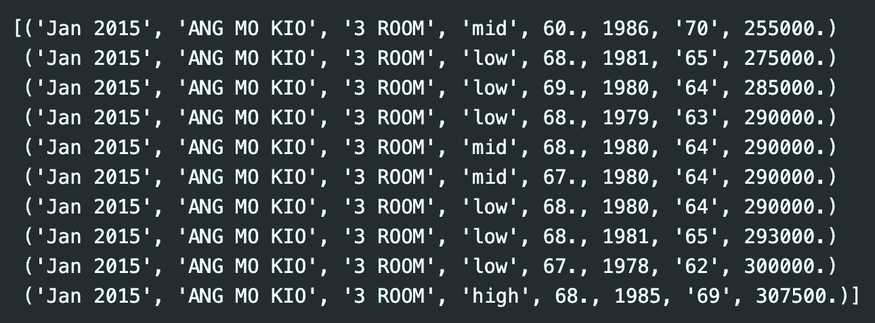
Resale Flat Prices
There are 180380 rows and 8 columns in this dataset
The names of the columns are:
month <class <U50>
town <class <U50>
flat_type <class <U50>
storey_range <class <U50>
floor_area_sqm <class float64>
lease_commence_date <class int64>
remaining_lease <class <U50>
resale_price <class float64>
Data transformations:
The dataset is a combination of data from the ‘2015 to 2016’ and ’2017 to present’ datasets

